Slide 1
Module 07 ”Object Lifetime”

Slide 2
Agenda
Introducing Lifetime
Enter Garbage Collection
Class Destructors
The Disposable Pattern

Slide 3
Lifespan of an Object
An object is created
Memory is allocated
Memory is initialized into an object by running the constructor
Object is alive and kicking
It is passed in and out of methods and operations are invoked
The object is destroyed
The object is de-initialized into unused memory
Memory is then deallocated
Notes:
Explain all four steps in details

Slide 4

Objects, Values, and Scope
static void Main()
{
bool b = true;
A longLivingVariable;
if( b )
{
int i = 0;
while( true )
{
A a = new A( i );
if( ++i % 100 == 0 )
{
longLivingVariable = a;
}
}
}
}
Local variables live only throughout the scope in which they are declared
Fixed lifetime
Scheduled destruction
Objects can outlive the scope in which the were allocated
Unbounded lifetime
Undetermined destruction

Slide 5
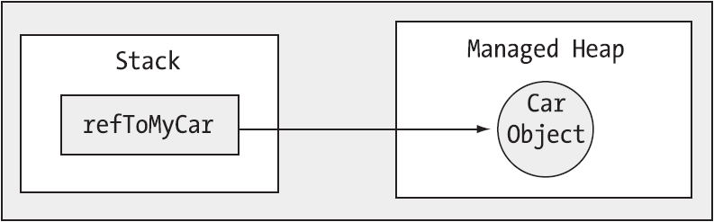
The Stack and The Heap
Local variables are allocated on the Stack
Objects are allocated on the Heap

Slide 6
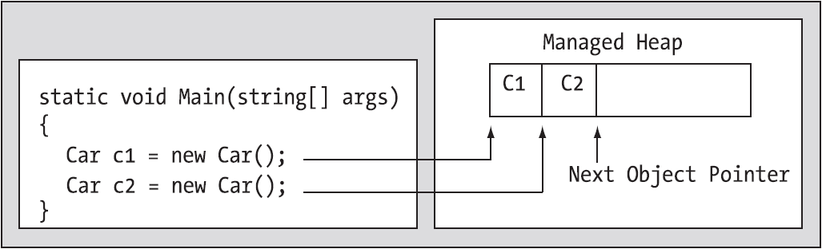
Allocating Objects
A new object is always allocated at The Next Object Pointer
This pointer is then advanced to the next block
Can this go on forever?
Notes:
Go back to the Slide 05 and show the corresponding Stack and Heap for a few iterations of the program

Slide 7
Deallocating Objects
There is no construct in C# to explicitly destroy objects
This is to avoid
Forgetting to destroy objects
Destroying more than once
Dangling references
…
The garbage collector finalizes the objects back into unused memory

Slide 8
Agenda
Introducing Lifetime
Enter Garbage Collection
Class Destructors
The Disposable Pattern

Slide 9
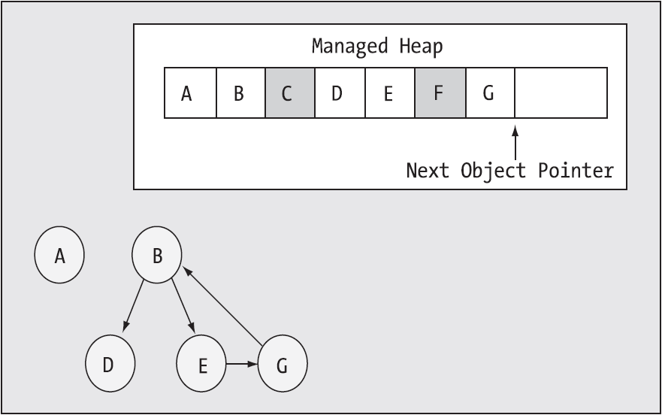
Object Graphs
1. Allocation is paused for a short while
2. Object graphs are created
Notes:
Setting references to null does not immediately deallocate the object (we will see that later)
Go back to the whiteboard example and perform a garbage collection!

Slide 10
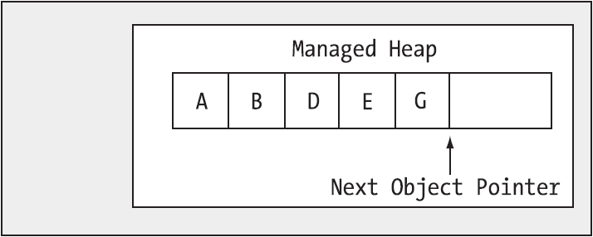
Heap Compaction
3. Those objects which are not referenced from Application Roots are deallocated
4. The Heap is then compacted
Notes:
Explain application roots
There is actually a “Large Object Heap” also, so compaction is not that expensive

Slide 11
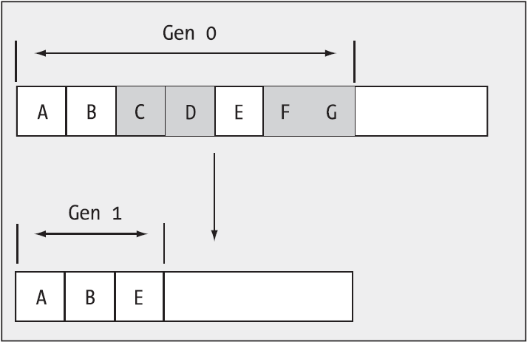
Generations
5. Generations are updated
6. New object is allocated as first new Generation 0 object
Notes:
Explain Generation 0, 1, and 2.
Discuss “Mid-Life Crisis” of the application
Except for Finalization, this is what happens… More later!

Slide 12
The System.GC Type
Name | Characteristics
Collect() | Forces a garbage collection given a generation a mode
SuppressFinalize() | Instructs that the object should not have its Finalize() method invoked
WaitForPendingFinalizers() | Suspends thread until all pending finalizable objects have been finalized
ReRegisterForFinalize() | Requests that the system calls the finalizer for the specified object
AddMemoryPressure() | Informs the CLR of a large allocation of unmanaged memory
RemoveMemoryPressure() | Informs the CLR of the deallocation of a large amount of unmanaged memory
KeepAlive() | Forces the object alive
There are more members of System.GC but most should be avoided!
Notes:
There are more members of System.GC but most should be avoided!!!
We will see SuppressFinalize() shortly
WaitForPendingFinalizers() is usually called immediately after Collect()
See example. Explain that setting = null does not readily incur a garbage collection
Show the modes of the Collect enumeration!

Slide 13
Agenda
Introducing Lifetime
Enter Garbage Collection
Class Destructors
The Disposable Pattern

Slide 14
The Finalize() Method
The garbage collector needs to know how to destroy objects
The cleanup logic for objects is performed in the Finalize() method inherited from System.Object
This virtual method cannot be overridden or called directly
Implement a class destructor to override Finalize()
If present, the garbage collector will invoke destructor just before turning object back into unused memory
Notes:
A destructor is basically IL-code for Finzalize()
Finalize() code should never block

Slide 15
Defining Destructors
Put cleanup logic in the destructor
Similar to constructors, the destructor is named after the class (but with ~)
Similar to constructors, destructors have no return type
No access modifier is allowed
Just a single destructor (with no parameters!) is allowed
class DataHandler
{ ...
FileStream fs;
~DataHandler()
{
fs.Close();
}
}
Notes:
This signals “Opposite of constructor”
This code should NEVER block!
Close database connection, clean up unmanaged resources, etc. etc.
Show example with object counters via the destructor

Slide 16
Destructors and Inheritance
Destructors are invoked by following the inheritance chain from most specialized first to most general last
class A
{
public A()
{
Console.WriteLine( "A()" );
}
~A()
{
Console.WriteLine( "~A()" );
}
}
class B : A
{
public B()
{
Console.WriteLine( "B()" );
}
~B()
{
Console.WriteLine( "~B()" );
}
}
B b = new B();
b = null;
GC.Collect();
GC.WaitForPendingFinalizers(); // ???
Notes:
Ask the students what will be displayed when running the program

Slide 17
Be Careful Out There!
The finalization process takes place after “ordinary” garbage collection
If your class has only managed resources, you should use a destructor!
Avoid destructors whenever possible
Costs time
Hard to debug
Prolongs object life and memory usage
Cannot know exactly when finalization takes place…!
Notes:
Explain how finalization proceeds with f-reachable etc. Takes two full cycles to complete
Happens on a separate thread
Destructors can have no thread affinity

Slide 18
Agenda
Introducing Lifetime
Enter Garbage Collection
Class Destructors
The Disposable Pattern

Slide 19
Two Approaches to Cleaning Up
Solution 1: Implement a destructor with cleanup logic
Solution 2: Implement an explicit Dispose() method and remember to invoke it!
Both solutions have shortcomings…
Best solution is to combine 1 + 2:
Try to remember to invoke Dispose() for deterministic cleanup
If you don’t, the garbage collector will eventually clean it up
This is the philosophy behind implementing IDisposable
public interface IDisposable
{
void Dispose();
}
Notes:
We will not dive into interfaces until the next section, but…

Slide 20

Implementing IDisposable
public class A : IDisposable
{
private bool _disposed = false;
public void Dispose()
{
CleanUp( true );
GC.SuppressFinalize( this );
}
private void CleanUp(bool disposing)
{
if( _disposed == false )
{
if( disposing )
{
// Dispose managed here
}
// Clean up unmanaged here.
}
_disposed = true;
}
~A()
{
CleanUp( false );
}
}
Notes:
Explain each line in the pattern and the idea behind it!
Run the accompanying example and demonstrate the Disposable pattern
Mention that for it to work for subclasses you have to resort to the exercises

Slide 21
Disposing Classes
Many .NET Framework classes implement IDisposable
You should always invoke Dispose() on objects if they implement IDisposable
In order to make the built-in classes more “natural”, there is often a Close() method which does the same as Dispose()
This of course makes it even more confusing… ☹
static void Main()
{
FileStream fs = new FileStream( "file.txt", FileMode.OpenOrCreate );
// These method both closes!
fs.Close(); // WTF???
fs.Dispose();
}
Notes:
The reason is that people don’t understand IDisposable and hence ignore it.
Do a snippet for it!!

Slide 22
The using Statement
The using statement is a convenient shorthand to help you to remember to Dispose()
Dispose() is always invoked at the end of the using block – even in the presence of exceptions!
Strive to use using whenever possible instead of manually invoking Dispose()
using( MyResourceWrapper rw = new MyResourceWrapper() )
{
rw.DoStuff();
...
}
Notes:
NOT to be confused with the “OTHER” using!!
Run the example
Show that using is just a try-finally!! (ask how they think it is realized)

Slide 23
Quiz: Object Lifetime – Right or Wrong?
class A
{
...
~A( int i )
{
Console.WriteLine( i );
}
public void DoStuff() { ... }
}
A a = new A();
~A();
A a = new A();
a.DoStuff();
a = null;
A a = new A();
a.DoStuff();
a.Dispose();
B b = new B();
b.DoStuff();
b.Dispose();
class B : IDisposable
{
public void Dispose() { ... }
public DoStuff() { ... }
}
using( B b = new B() )
{
b.DoStuff();
}
Notes:
A definition: Wrong. Destructors don’t take parameters.
B definition: Right.
Usage 1: Wrong. Cannot call destructors directly.
Usage 2: Right, but… Null does not really clean up object.
Usage 3: Wrong. A.Dispose() does not exist.
Usage 4: Maybe, but… Dangerous because of potential exceptions.
Usage 5: Right.

Slide 24
Summary
Introducing Lifetime
Enter Garbage Collection
Class Destructors
The Disposable Pattern

Slide 25
Question
You are creating a class referencing unmanaged resources. Also it maintains references to managed resources on other objects. You must ensure that the class can be explicitly cleaned up. Which three actions should you perform? (Each correct answer presents part of the solution. Choose three.)

Slide 26
Question (Cont’d)
Make the class derive from the System.GC.CleanUp class.
Make the class implement the IDisposable interface.
Create a Dispose method which cleans up unmanaged resources and calls methods to release the referenced managed resources.
Create a Dispose method that calls System.GC.Collect to force garbage collection.
Create a class destructor that releases the unmanaged resources.
Create a class destructor that calls methods to release the referenced managed resources.

